Slide 1
Python Module II
Tuple, Dictionary, Module(Package),I/O, Class

Slide 2
Python Tuple
A tuple is a sequence of immutable objects
The objects are enclosed within parenthesis ( ) and separated by comma.
Tuple is similar to list.
Tuple have immutable objects.
NOTE: If Parenthesis is not given with a sequence, it is by default treated as Tuple.

Slide 3
There can be an empty Tuple also which contains no object.
>>>tuple1=()
For a single valued tuple, there must be a comma at the end of the value.
>>>Tuple1=(10,)
Tuples can also be nested.
>>>tupl1='a','mahesh',10.56
>>>tupl2=tupl1,(10,20,30)
>>>print (tupl1) // ('a', 'mahesh', 10.56)
>>>print (tupl2) //(('a', 'mahesh', 10.56), (10, 20, 30))

Slide 4
Accessing Tuple
Tuple can be accessed in the same way as List.
Some examples are given below:
>>>data1=(1,2,3,4)
>>>data2=('x','y','z')
>>>print (data1[0] )
>>>print (data1[0:2] )
>>>print (data2[-3:-1])
>>>print (data1[0:] )
>>>print (data2[:2])

Slide 5
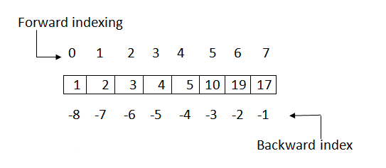
Data=(1,2,3,4,5,10,19,17)
Data=(1,2,3,4,5,10,19,17)

Slide 6
Tuple Operations
a) Adding Tuple:
Tuple can be added by using the concatenation operator(+) to join two tuples.
eg:
>>>data1=(1,2,3,4)
>>>data2=('x','y','z')
>>>data3=data1+data2
>>>print( data1 ) // (1,2,3,4)
>>>print( data2 ) // ('x','y','z')
>>>print( data3 ) // (1,2,3,4, 'x','y','z‘)

Slide 7
>>>tuple1=(10,20,30)
>>>tuple2=(40,50,60)
>>>print (tuple1*2)
>>>print (tuple2*3)

Slide 8
Deleting a Tuple
# Code for deleting a tuple
tuple3 = ( 0, 1)
del tuple3
print(tuple3)
Finding Length of a Tuple
# Code for printing the length of a tuple
tuple2 = ('python', 'geek')
print(len(tuple2))

Slide 9
Converting list to a Tuple
# Code for converting a list and a string into a tuple
list1 = [0, 1, 2]
print(tuple(list1))
print(tuple('python')) # string 'python'
Output
(0, 1, 2)
('p', 'y', 't', 'h', 'o', 'n')
Takes a single parameter which may be a list, string, set or even a dictionary( only keys are taken as elements) and converts them to a tuple.

Slide 10
Using cmp(), max() , min()
# cmp() returns 0 if matched, 1 when tuple1 is longer and -1 when tuple1 is shorter
tuple1 = ('python', 'geek')
tuple2 = ('coder', 1)
if (cmp(tuple1, tuple2) != 0):
print('Not the same')
else:
print('Same')
print ('Maximum element in tuples 1,2: ' + str(max(tuple1)) + ',' +
str(max(tuple2)))
print ('Minimum element in tuples 1,2: ' + str(min(tuple1)) + ',' + str(min(tuple2)))

Slide 11
Output
Not the same
Maximum element in tuples 1,2: python,coder
Minimum element in tuples 1,2: geek,1
Note: max() and min() checks the based on ASCII values. If there are two strings in a tuple, then the first different character in the strings are checked.

Slide 12
Why Use Tuple?
Processing of Tuples are faster than Lists.
It makes the data safe as Tuples are immutable and hence cannot be changed.
Tuples are used for String formatting.

Slide 13
Dictionary in Python
In python, dictionary is similar to hash or maps in other languages.
It consists of key value pairs.
The value can be accessed by unique key in the dictionary.
Dictionary is mutable i.e., value can be updated.
Keys must be immutable.
Value is accessed by key.
Value can be updated while key cannot be changed.
Dictionary is known as Associative array since the Key works as Index and they are decided by the user.

Slide 14
# Create a new dictionary
d = dict() # or d = {}
# Add a key - value pairs to dictionary
d['xyz'] = 123
d['abc'] = 345
# print the whole dictionary
print (d)
# print only the keys
print (d.keys())
# print only values
print (d.values())

Slide 15
# iterate over dictionary
for i in d :
print "%s %d" %(i, d[i])
# another method of iteration
for index, value in enumerate(d):
print (index, value , d[value])
# check if key exist
print ('xyz' in d)
# delete the key-value pair
del d['xyz']
# check again
print ("xyz" in d)

Slide 16
Output:
{'xyz': 123, 'abc': 345}
['xyz', 'abc']
[123, 345]
xyz 123
abc 345
0 xyz 123
1 abc 345
True
False

Slide 17
Dictionary Methods in Python
1. str(dic) :- This method is used to return the string, denoting all the dictionary keys with their values.
2. items() :- This method is used to return the list with all dictionary keys with values.
# Initializing dictionary
dic = { 'Name' : ‘RAM', 'Age' : 19 }
# using str() to display dic as string
print (str(dic)) #’{'Name': ‘RAM', 'Age': 19}’
# using str() to display dic as list
print (dic.items()) #dict_items([('Name', 'Nandini'), ('Age', 19)])

Slide 18
3. len() :- It returns the count of key entities of the dictionary elements.
dic = { 'Name' : 'Nandini', 'Age' : 19, 'ID' : 2541997 }
# using len() to display dict. size
print (len(dic)) # 3

Slide 19
4. copy() :- This function creates the copy of the dictionary into other dictionary.
5. clear() :- This function is used to clear the dictionary contents.
dic1 = { 'Name' : 'Nandini', 'Age' : 19 }
dic3 = {}
# using copy() to make shallow copy of dictionary
dic3 = dic1.copy()
# printing new dictionary
print (dic3) # { 'Name' : 'Nandini', 'Age' : 19 }
# clearing the dictionary
dic1.clear()
# printing cleared dictionary
print (dic1.items()) # {}

Slide 20
Deletion: del statement is used for performing deletion operation.
An item can be deleted from a dictionary using the key.
del [key]
Whole of the dictionary can also be deleted using the del statement.
data={100:'Ram', 101:'Suraj', 102:'Alok'}
del data[102]
print (data)
del data
print (data) #will show an error since dictionary is deleted.

Slide 21
Dictionary Functions
Functions | Description
len(dictionary) | Gives number of items in a dictionary.
cmp(dictionary1,dictionary2) | Compares the two dictionaries.
str(dictionary) | Gives the string representation of a dictionary.

Slide 22
Dictionary Methods
Methods | Description
keys() | Return all the keys element of a dictionary.
values() | Return all the values element of a dictionary.
items() | Return all the items(key-value pair) of a dictionary.
update(dictionary2) | It is used to add items of dictionary2 to first dictionary.
clear() | It is used to remove all items of a dictionary. It returns an empty dictionary.
fromkeys(sequence,value1)/ fromkeys(sequence) | It is used to create a new dictionary from the sequence where sequence elements forms the key and all keys share the values ?value1?. In case value1 is not give, it set the values of keys to be none.
has_key(key) | It returns a boolean value. True in case if key is present in the dictionary ,else false.
get(key) | Returns the value of the given key. If key is not present it returns none.

Slide 23
>>>data1={100:'Ram', 101:'Suraj', 102:'Alok'}
>>>print (data1.keys() )
Output:
[100, 101, 102]
>>>print data1.values()
Output:
['Ram', 'Suraj', 'Alok‘]

Slide 24
>>>print (data1.items())
Output:
[(100, 'Ram'), (101, 'Suraj'), (102, 'Alok')]
>>>data1={100:'Ram', 101:'Suraj', 102:'Alok'}
>>>data2={103:'Sanjay'}
>>>data1.update(data2)
>>>print (data1)
>>>print (data2)
Output:
{100: 'Ram', 101: 'Suraj', 102: 'Alok', 103: 'Sanjay'}
{103: 'Sanjay'}

Slide 25
sequence=('Id' , 'Number' , 'Email')
data={}
data1={}
data=data.fromkeys(sequence)
print (data)
data1=data1.fromkeys(sequence,100)
print (data1)
Output:
{'Email': None, 'Id': None, 'Number': None}
{'Email': 100, 'Id': 100, 'Number': 100}

Slide 26
data={'Id':100 , 'Name':'Aakash' , 'Age':23}
print (data.has_key('Age'))
print (data.has_key('Email'))
Output:
True
False

Slide 27
data={'Id':100 , 'Name':'Aakash' , 'Age':23}
print (data.get('Age'))
print (data.get('Email')
Output:
23
None

Slide 28
d={int(x):z for x in input('keys ').split() for z in input('values ').split()}
keys 1 2 3 4 5 6
values a
values b
values c
values d
values e
values f
print(d)
{1: 'a', 2: 'b', 3: 'c', 4: 'd', 5: 'e', 6: 'f'}

Slide 29
Python Modules
Modules refer to a file containing Python statements and definitions.
A file containing Python code, for e.g.: example.py, is called a module and its module name would be example.
We use modules to break down large programs into small manageable and organized files.
Furthermore, modules provide reusability of code.
We can define our most used functions in a module and import it, instead of copying their definitions into different programs.

Slide 30
# Python Module example(example.py)
def add(a, b):
"""This program adds two numbers and return the result"""
result = a + b
return result
Here, we have defined a function add() inside a module named example(SAVE THE FILE WITH example.py)

Slide 31
How to import modules in Python?
We can import the definitions inside a module to another module or the interactive interpreter in Python.
>>> import example
>>> example.add(4,5.5)
9.5

Slide 32
1. Python import statement We can import a module using import statement and access the definitions inside it using the dot operator.
# import statement example
# to import standard module math
>>>import math
>>>print("The value of pi is", math.pi)
The value of pi is 3.141592653589793

Slide 33
2. Import with renaming We can import a module by renaming it as follows.
>>># import module by renaming it
>>>import math as m
>>>print("The value of pi is", m.pi)

Slide 34
3. Python from...import statement We can import specific names form a module without importing the module as a whole.
>>># import only pi from math module
>>>from math import pi
>>>print("The value of pi is", pi)

Slide 35
>>> from math import pi, e
>>> pi 3.141592653589793
>>> e 2.718281828459045

Slide 36
4. Import all names We can import all names(definitions) form a module using the following construct.
>>># import all names form
>>># the standard module math
>>>from math import *
>>>print("The value of pi is", pi)

Slide 37
Reloading a module
The Python interpreter imports a module only once during a session.
Suppose we have the following code in a module named my_module.
>>># This module shows the effect of multiple imports and reload
>>>print("This code got executed")
Now we see the effect of multiple imports.
>>> import my_module
This code got executed
>>> import my_module
>>> import my_module

Slide 38
Now if our module changed during the course of the program, we would have to reload it.
One way to do this is to restart the interpreter.
Python provides a neat way of doing this.
We can use the reload() function inside the imp module to reload a module.
>>> import imp
>>> import my_module
This code got executed
>>> import my_module
>>> imp.reload(my_module)
This code got executed <module 'my_module' from '.\\my_module.py'>

Slide 39
Python Package
We don't usually store all of our files in our computer in the same location.
We use a well-organized hierarchy of directories for easier access.
Similar files are kept in the same directory, for example, we may keep all the songs in the "music" directory.
Analogous to this, Python has packages for directories and modules for files.
As our application program grows larger in size with a lot of modules, we place similar modules in one package and different modules in different packages.
This makes a project (program) easy to manage and conceptually clear.

Slide 40
Similar, as a directory can contain sub-directories and files, a Python package can have sub-packages and modules.
A directory must contain a file named __init__.py in order for Python to consider it as a package.
This file can be left empty but we generally place the initialization code for that package in this file.

Slide 41
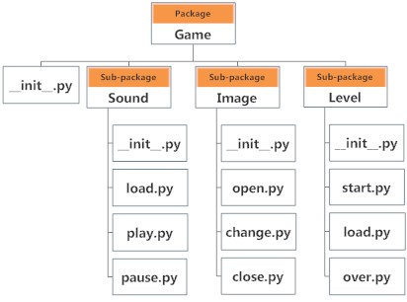

Slide 42
Importing module from a package
We can import modules from packages using the dot (.) operator.
For example to import the start module in the above example
And if this module contains function named select_difficulty()
>>>import Game.Level.start
>>>Game.Level.start.select_difficulty()
OR
>>>from Game.Level import start
>>>start.select_difficulty()

Slide 43
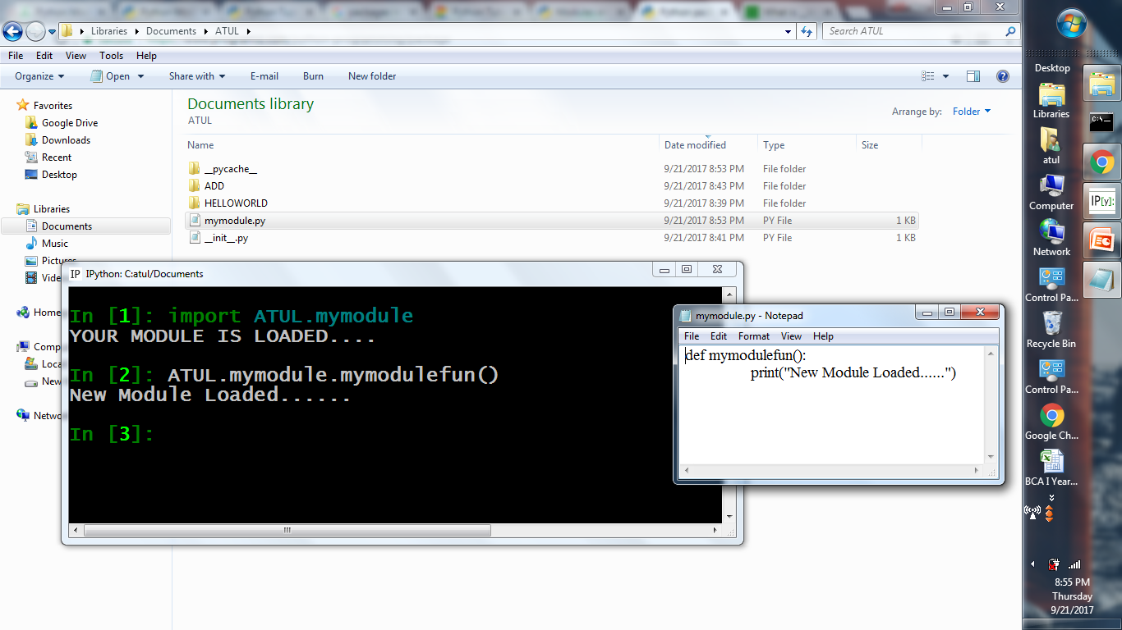

Slide 44
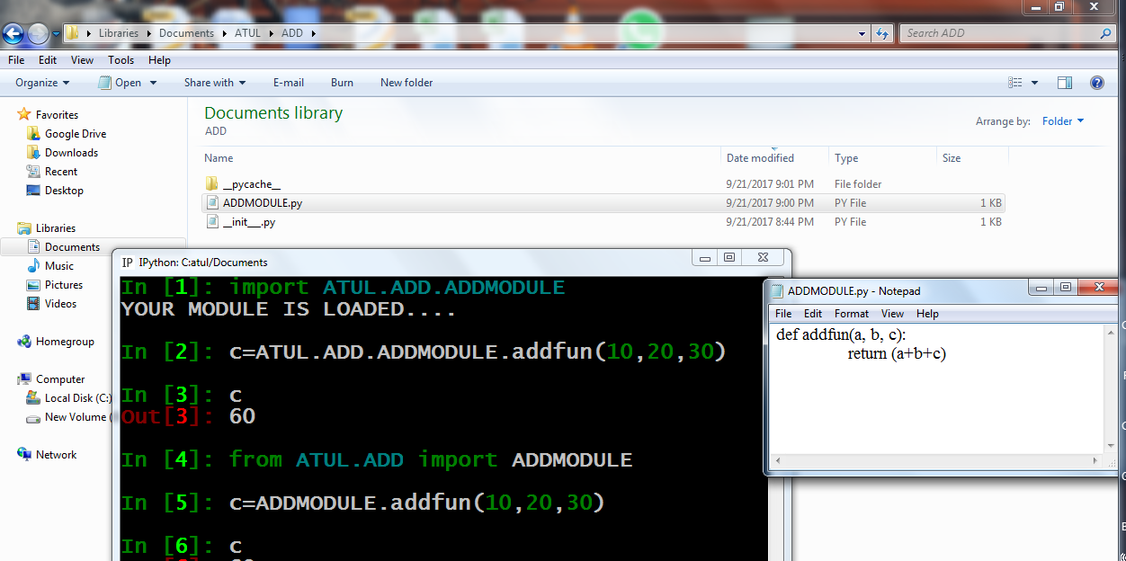

Slide 45
Python I/O
The actual syntax of the print() function is
>>>print(*objects, sep=' ', end='\n', file=sys.stdout, flush=False)
Here, objects is the value(s) to be printed.
The sep separator is used between the values.
It defaults into a space character.
After all values are printed, end is printed.
It defaults into a new line.
The file is the object where the values are printed and its default value is sys.stdout(screen).
flush is False. The stream is not forcibly flushed.

Slide 46
>>>print(1,2,3,4)
1 2 3 4
>>>print(1,2,3,4,sep='*')
1*2*3*4
>>>print(1,2,3,4,sep='#',end='&')
1#2#3#4&

Slide 47
>>>A = open("data.txt","w")
>>> print(“Lets! Dive into the World of Python", file=A)
>>> A.close()
We can see that we don't get any output in the interactive shell.
The output is sent to the file "data.txt".

Slide 48
Python Input
The syntax for input() is
>>>input([prompt])
Prompt is the string we wish to display on the screen.
It is optional.

Slide 49
File Handling
File is a named location on disk to store related information.
It is used to permanently store data in a non-volatile memory (e.g. hard disk).
When we want to read from or write to a file we need to open it first.
When we are done, it needs to be closed, so that resources that are tied with the file are freed.
File operation takes place in the following order.
Open a file
Read or write (perform operation)
Close the file

Slide 50
open()
Before you can read or write a file, you have to open it using Python's built-in open() function.
This function creates a file object, which would be utilized to call other support methods associated with it.
Syntax
file object = open(file_name [, access_mode][, buffering])

Slide 51
file_name
The file_name argument is a string value that contains the name of the file that you want to access.

Slide 52
Access modes of a file
access_mode − The access_mode determines the mode in which the file has to be opened, i.e., read, write, append, etc. The default file access mode is read (r).
r
Opens a file for reading only.
The file pointer is placed at the beginning of the file.
This is the default mode.
rb
Opens a file for reading only in binary format.

Slide 53
r+
Opens a file for both reading and writing.
The file pointer placed at the beginning of the file.(file must exist)
rb+
Opens a file for both reading and writing in binary format.
The file pointer placed at the beginning of the file.

Slide 54
w
Opens a file for writing only.
Overwrites the file if the file exists.
If the file does not exist, creates a new file for writing.
wb
Opens a file for writing only in binary format.
Overwrites the file if the file exists.
If the file does not exist, creates a new file for writing.

Slide 55
w+
Opens a file for both writing and reading.
Overwrites the existing file if the file exists.
If the file does not exist, creates a new file for reading and writing.
wb+
Opens a file for both writing and reading in binary format.
Overwrites the existing file if the file exists.
If the file does not exist, creates a new file for reading and writing.

Slide 56
a
Opens a file for appending.
The file pointer is at the end of the file if the file exists.
That is, the file is in the append mode.
If the file does not exist, it creates a new file for writing.
ab
Opens a file for appending in binary format.
The file pointer is at the end of the file if the file exists.
That is, the file is in the append mode.
If the file does not exist, it creates a new file for writing.

Slide 57
a+
Opens a file for both appending and reading.
The file pointer is at the end of the file if the file exists.
The file opens in the append mode.
If the file does not exist, it creates a new file for reading and writing.
ab+
Opens a file for both appending and reading in binary format.
The file pointer is at the end of the file if the file exists.
The file opens in the append mode.
If the file does not exist, it creates a new file for reading and writing.

Slide 58
buffering − If the buffering value is set to 0, no buffering takes place.
If the buffering value is 1, line buffering is performed while accessing a file.
If you specify the buffering value as an integer greater than 1, then buffering action is performed with the indicated buffer size.
If negative, the buffer size is the system default(default behavior).

Slide 59
How to open a file?
Python has a built-in function open() to open a file.
This function returns a file object, also called a handle, as it is used to read or modify the file accordingly.
>>> f = open("test.txt")
# open file in current directory
>>> f = open("C:/Python33/README.txt")
# specifying full path

Slide 60
The file Object Attributes
Once a file is opened and you have one file object, you can get various information related to that file.
file.closed Returns true if file is closed, false otherwise.
file.mode Returns access mode with which file was opened.
file.name Returns name of the file.

Slide 61
# Open a file
>>>fo = open("foo.txt", "wb")
>>>print ("Name of the file: ", fo.name)
>>>print ("Closed or not : ", fo.closed)
>>>print ("Opening mode : ", fo.mode)
>>>fo.close()
This produces the following result −
Name of the file: foo.txt
Closed or not : False
Opening mode : wb

Slide 62
The close() Method
It flushes any unwritten information and closes the file object, after which no more writing can be done.
Python automatically closes a file when the reference object of a file is reassigned to another file.
It is a good practice to use the close() method to close a file.
>>>fileObject.close()

Slide 63
Reading and Writing Files
The write() Method
The write() method writes any string to an open file.
The write() method does not add a newline character ('\n') to the end of the string
Syntax
>>>fileObject.write(string);
Here, passed parameter is the content to be written into the opened file.

Slide 64
# Open a file
>>>fo = open("foo.txt", "w")
>>>fo.write( "Python is a great language.\nYeah its great!!\n")
# Close opend file
>>>fo.close()

Slide 65
The read() Method
The read() method reads a string from an open file.
Syntax
>>>fileObject.read([count])
Here, passed parameter is the number of bytes to be read from the opened file.
This method starts reading from the beginning of the file and
if count is missing, then it tries to read as much as possible, maybe until the end of file.

Slide 66
readline()
readline() can help you to read one line each time from the file.
>>> fobj = open("sample.txt")
>>> fobj.readline()
To read all the lines in a list we use readlines() method.
>>> fobj = open("sample.txt")
>>> fobj.readlines()

Slide 67
# Open a file
>>>fo = open("foo.txt", "r+")
>>>str = fo.read(10)
>>>print ("Read String is : ", str)
# Close opened file
>>>fo.close()
Output:
Read String is : Python is

Slide 68
File Positions
The tell() method tells you the current position within the file;
in other words, the next read or write will occur at that many bytes from the beginning of the file.

Slide 69
seek(offset[, from])
This method changes the current file position.
The offset argument indicates the number of bytes to be moved.
The from argument specifies the reference position from where the bytes are to be moved.
If from is set to 0, the beginning of the file is used as the reference position.
If it is set to 1, the current position is used as the reference position.
If it is set to 2 then the end of the file would be taken as the reference position.

Slide 70
# Open a file
fo = open("foo.txt", "r+")
str = fo.read(10)
print ("Read String is : ", str)
# Check current position
position = fo.tell()
print ("Current file position : ", position)
# Reposition pointer at the beginning once again
position = fo.seek(0, 0)
str = fo.read(10)
print ("Again read String is : ", str)
# Close opened file
fo.close()

Slide 71
We can read a file line-by-line using a for loop.
This is both efficient and fast.
>>> for line in f:
print(line, end = '')
This is my
first file
This file contains three lines

Slide 72
How to write to File Using Python?
In order to write into a file in Python, we need to open it in write 'w‘ or append 'a‘.
We need to be careful with the 'w' mode as it will overwrite into the file if it already exists. All previous data are erased.
Writing a string is done using write() method.
This method returns the number of characters written to the file.

Slide 73
Using the with statement
In real life scenarios we should try to use with statement.
It will take care of closing the file for you.
>>> with open(‘filename.txt') as fobj:
for line in fobj:
print (line)

Slide 74
>>>with open("test.txt",'w',encoding = 'utf-8') as f: f.write("my first file\n")
f.write("This file\n\n")
f.write("contains three lines\n")

Slide 75
we can use readline() method to read individual lines of a file.
This method reads a file till the newline, including the newline character.
>>> f.readline()
'This is my first file\n'
>>> f.readline()
'This file\n'
>>> f.readline()
'contains three lines\n'
>>> f.readline() ''

Slide 76
the readlines() method returns a list of remaining lines of the entire file.
All these reading method return empty values when end of file (EOF) is reached.
>>> f.readlines()
['This is my first file\n', 'This file\n', 'contains three lines\n']

Slide 77
with open("name.txt","r") as namefile:
with open("Message.txt","r") as messagefile:
text=messagefile.read()
for name in namefile:
mail="Dear Mr."+name+text
with open(name.strip()+".txt",'w') as mailfile:
mailfile.write(mail)

Slide 78
Python Classes
A class is a Python object with several characteristics:
You can call a class object as if it were a function.
The call returns another object, known as an instance of the class;
The class is also known as the type of the instance.
A class has arbitrarily named attributes that you can bind and reference.
The values of class attributes can be descriptors (including functions), or normal data objects.

Slide 79
Class attributes bound to functions are also known as methods of the class.
A method can have a special Python-defined name with two leading and two trailing underscores.
Python implicitly invokes such special methods, if a class supplies them, when various kinds of operations take place on instances of that class.

Slide 80
In Python, classes are objects (values) and are handled like other objects.
Thus, you can pass a class as an argument in a call to a function.
Similarly, a function can return a class as the result of a call.
A class, just like any other object, can be bound to a variable (local or global), an item in a container, or an attribute of an object.
Classes can also be keys into a dictionary.
The fact that classes are ordinary objects in Python is often expressed by saying that classes are first-class objects.

Slide 81
The class Statement
The class statement is the most common way to create a class object.
class classname(base-classes):
statement(s)
classname is an identifier.
It is a variable that gets bound to the class object after the class statement finishes executing.

Slide 82
The Class Body
The body of a class is where you normally specify the attributes of the class;
These attributes can be descriptor objects (including functions) or
Normal data objects of any type (an attribute of a class can also be another class).

Slide 83
Object Oriented Programming in Python
Creating Classes:
The class statement creates a new class definition.
class ClassName:
```Optional class documentation string```
class_suite
The class has a documentation string, which can be accessed
via ClassName.__doc__
The class_suite consists of all the component statements defining class members, data attributes and functions.

Slide 84
>>>class test:
def show(self):
print("SHOW METHOD")
>>>a=test()
>>>a.show()
Output:
SHOW METHOD

Slide 85
In [1]: class test:
...: def show():
...: print("Message")
...:
In [2]: a=test()
In [3]: a.show() ## test.show(a)
---------------------------------------------------------------------------
TypeError Traceback (most recent call last)
<ipython-input-3-276f7237b96c> in <module>()
----> 1 a.show()
TypeError: show() takes 0 positional arguments but 1 was given

Slide 86
self in Python…???
class Point(object):
def __init__(self,x = 0,y = 0):
self.x = x
self.y = y
def distance(self):
"""Find distance from origin""" return (self.x**2 + self.y**2) ** 0.5

Slide 87
Let us now instantiate this class and find the distance.
>>> p1 = Point(6,8)
>>> p1.distance()
10.0
In the above example, __init__() defines three parameters but we just passed two (6 and 8).
Similarly distance() requires one but zero arguments were passed.
Why is Python not complaining about this argument number mismatch?

Slide 88
What Happens Internally?
Point.distance and p1.distance in the above example are a bit different.
>>> type(Point.distance)
<class 'function'>
>>> type(p1.distance)
<class 'method'>

Slide 89
A peculiar thing about methods (in Python) is that the object itself is passed on as the first argument to the corresponding function……………IMPLICIT
the method call p1.distance() is actually equivalent to Point.distance(p1).
Generally, when we call a method with some arguments, the corresponding class function is called by placing the method's object before the first argument.
So, anything like obj.meth(args) becomes Class.meth(obj, args).
The calling process is automatic while the receiving process is not (its explicit).

Slide 90
class student:
count=0 # class variable
def __init__(self, na, ma):
print("Constructor invoked")
self.name=na
self.marks=ma
student.count=student.count+1
def display(self):
print("NAME ",self.name)
print("MARKS ",self.marks)
def total(self):
print("Total students ",student.count)

Slide 91
a=student("abc",99) #Constructor invoked
b=student("xyz",88) #Constructor invoked
a.display() #NAME abc
#MARKS 99
b.display() #NAME xyz
#MARKS 88
student.count # 2
a.count # 2
b.Count # 2

Slide 92
The variable count is a class variable whose value is shared among all the instances of the class.
This can be accessed as student.count from inside the class or outside the class.
The first method __init__() is a special method, which is called initialization method that Python calls when you create a new instance of this class.

Slide 93
class test:
var="aa"
def fun(self,str):
print("something")
self.var=self.var+str
a=test()
b=test()
a.fun("zz") #something
print(a.var) # 'aazz‘
print(b.var) # 'aa'

Slide 94
class test:
var="aa"
def fun(self,str):
print("something")
self.var=self.var+str
test.var=test.var+str+str
c=test()
d=test()
c.var 'aa'
d.var 'aa'
c.fun("zzz“)
c.var 'aazzz'
d.var 'aazzzzzz'

Slide 95
You declare other class methods like normal functions with the exception that the first argument to each method is self.
Python adds the self argument to the list for you; you do not need to include it when you call the methods.

Slide 96
Creating Instance Objects
To create instances of a class, you call the class using class name and pass in whatever arguments its __init__ method accepts.

Slide 97
Accessing Attributes
Instead of using the normal statements to access attributes, you can use the following functions-
You access the object's attributes using the dot operator with object.
Class variable would be accessed using class name.

Slide 98
class Point:
def __init__( self, x=0, y=0):
self.x = x
self.y = y
def __del__(self):
class_name = self.__class__.__name__
print (class_name, "destroyed")
pt1 = Point()
pt2 = pt1
pt3 = pt1
print (id(pt1), id(pt2), id(pt3) # prints the ids of the obejcts)
del pt1
del pt2
del pt3

Slide 99
When the above code is executed, it produces the following result-
3083401324 3083401324 3083401324
Point destroyed

Slide 100
Class Inheritance
It refers to defining a new class with little or no modification to an existing class.
The new class is called derived (or child) class and the one from which it inherits is called the base (or parent) class.
class BaseClass:
Body of base class class
class DerivedClass(BaseClass):
Body of derived class
https://pythonlobby.com/inheritance-and-types-of-inheritance-in-python-programming/

Slide 101
class polygon:
def __init__(self, sides):
self.n=sides
self.s=[int(input("Enter side ")) for i in range(self.n)]
def display(self):
for i in range(self.n):
print(self.s[i])

Slide 102
a=polygon(3)
Enter side 12
Enter side 34
Enter side 45
a.display()
12
34
45

Slide 103
class triangle(polygon):
def __init__(self):
polygon.__init__(self, 3) #super().__init__(3)
def area(self):
a,b,c=self.s
S=(a+b+c)/2
ar=(S*(S-a)*(S-b)*(S-c))**0.5
print(ar)
t=triangle()
Enter side 11
Enter side 223
Enter side 122
t.area()

Slide 104
class A:
def fun(self):
print("A")
class B(A):
def fun(self):
super().fun()
print("B")
class C(A):
def fun(self):
super().fun()
print("C")
class D(B,C):
def fun(self):
super().fun()
print("D")
d=D()
d.fun()
OUTPUT:
A
B
C
D

